Slide 1
Version control training
Presenter
Mayukh Sinha (SDET - 2)
Kushagra Kapoor (Team Lead)

Slide 2
Agenda
1
What is Version Control
2
What is Git and GitHub
3
Gitbash and Source Tree and Github Architecture
4
Git Clone and Git Fork
5
.GIT Folder and .gitignore File
6
Git commands: git remote, log, checkout, clean, reset
7
How to create a Pull Request
8
Rebase Pull Request and amend commit

Slide 3


What is Version Control
Version control is a system that tracks and manages changes to files and directories, enabling collaboration, error recovery, and history tracking for projects with multiple contributors.
Benefits:
improves collaboration between tech and non-tech teams and stakeholders.
tracks changes, and maintains a history of who made what changes, when, and why.
It helps prevent conflicts when multiple contributors work on a project.
Facilitates error recovery.
SOTI Confidential - Only for use under NDA - Do not distribute

Slide 4


What is git and GitHub?
Git is a distributed version control system used to track changes in source code during software development. It allows multiple contributors to work on a project collaboratively.
GitHub, on the other hand, is a web-based platform that hosts Git repositories and provides additional collaboration and project management features. It serves as a platform for developers to share, collaborate on, and manage Git repositories, making it a popular choice for open-source and private software development projects.

Slide 5
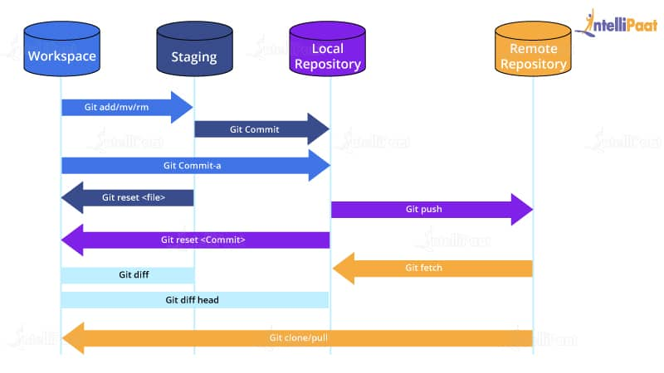
Github architecture

Slide 6


git bash and source tree
GitBash:
Type: GitBash is a command-line interface (CLI) tool.
User Interface: It provides a text-based interface for interacting with Git, where you enter commands and arguments manually.
Flexibility: Offers more flexibility and control over Git operations, making it suitable for users comfortable with the command line.
Scripting: Allows scripting and automation of Git tasks using shell scripts.
Learning Curve: May have a steeper learning curve for users who are not familiar with the command line.
SourceTree:
Type: SourceTree is a graphical user interface (GUI) tool.
User Interface: It offers a visual interface with buttons, menus, and interactive elements for managing Git repositories.
User-Friendly: Designed for users who prefer a more user-friendly and intuitive approach to Git.
Visual Representation: Provides a visual representation of the Git repository's history and branches, making it easier to understand.
Cross-Platform: SourceTree is available for both Windows and macOS.
Integration: Integrates with other tools and services, including GitHub, Bitbucket, and GitLab.

Slide 7
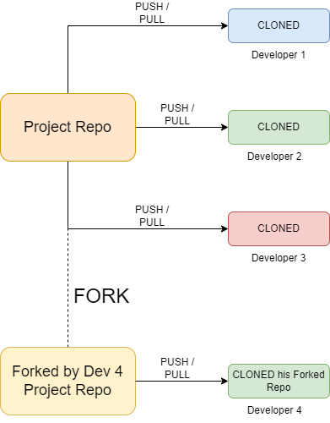
GIT CLONE AND GIT FORK
git clone creates a copy of a Git repository from a remote server to your local machine for personal use.
git fork creates a copy on a Git hosting platform like GitHub, allowing you to contribute to the project by proposing changes and keeping your copy linked to the original repository.

Slide 8
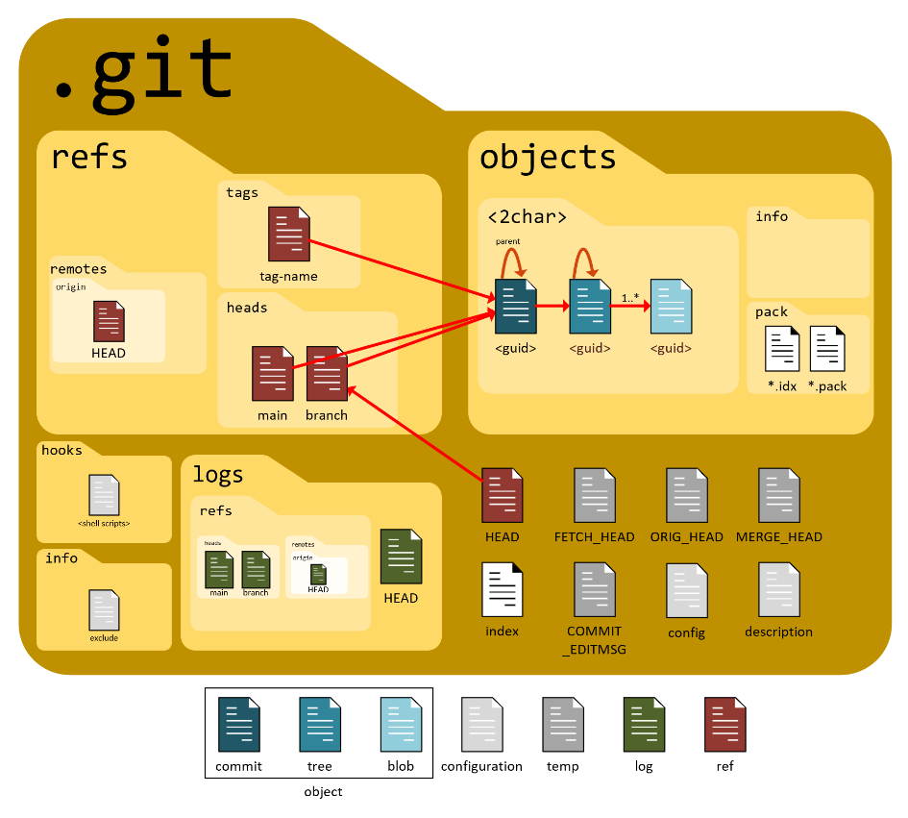
.git folder and .GITIGNORE FILE
.git Folder: The .git folder is the core of a Git repository. It stores the version history, branches, configuration, and other metadata. Essential for tracking changes, managing branches, and collaborating on projects.
.gitignore File: A file that specifies intentionally untracked files to be ignored by Git. Helps avoid committing files such as build artifacts, logs, or user-specific configurations. Enhances version control cleanliness and avoids unnecessary clutter in repositories.

Slide 9
GIT REMOTE
In Git, a "remote" is a common term used to refer to a repository that is hosted on another server. The git remote command is used to manage a list of these remote repositories associated with a local repository.
To see more detailed information about each remote, such as the URL of the remote repository, you can use: git remote –v
To add a new remote repository, you can use the git remote add command. For example, to add a remote named "upstream," you would do: git remote add upstream <repository-url>
If the URL of a remote repository changes, you can update it using the git remote set-url command. For example: git remote set-url origin <new-repository-url>

Slide 10
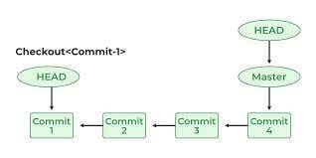
GIT checkout
git checkout: To switch to an existing branch, you use git checkout followed by the branch name/ commit id.
Head creates a copy on a Git hosting platform like GitHub, allowing you to contribute to the project by proposing changes and keeping your copy linked to the original repository.

Slide 11
GIT LOG
Git log: The git log command in Git is used to display a chronological history of commits in a Git repository. It provides a detailed log of the commit history, including commit messages, author information, dates, and commit hashes.
Git log –oneline: option to display a concise, one-line summary for each commit, including the abbreviated commit hash and commit message.
git log –p: The -p option shows the diff (changes) introduced in each commit.
git log -n 3: You can use the -n option to limit the number of commits displayed.

Slide 12
GIT reset
git reset –soft <commit>: Only the branch pointer and the HEAD are moved to the specified commit, leaving the staging area and working directory unchanged.
Git reset –hard <commit>: The branch pointer and the HEAD are moved to the specified commit, and the staging area is reset to match the specified commit.
To undo the last commit and keep changes in your working directory: git reset --soft HEAD^
To undo the last commit and discard changes in your working directory: git reset --hard HEAD^

Slide 13
GIT CLEAN
The git clean command is used to remove untracked files and directories from your working directory. Untracked files are those that Git is not currently managing, either because they have been created since the last commit or because they are listed in the .gitignore file.
-d (or --directory): This option tells Git to also remove untracked directories in addition to untracked files.Without this option, git clean only removes untracked files by default.
-f (or --force): This option is required to force the clean operation. Git is cautious about removing untracked files to prevent accidental data loss, so this flag is necessary to confirm that you indeed want to delete the untracked files and directories.
-x (or --ignored): This option makes git clean remove not only untracked files but also untracked directories that are specified in the .gitignore file. It is useful when you want to clean up both tracked and ignored files.

Slide 14
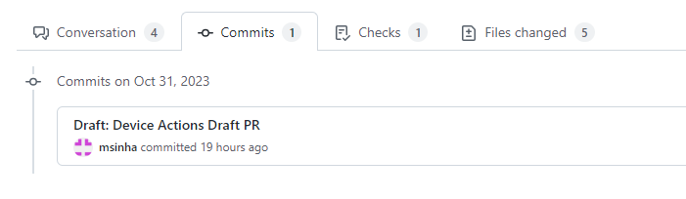
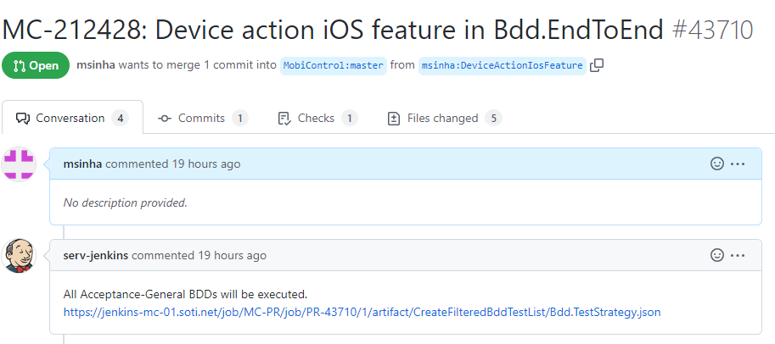
Commits and Pull Requests
Commit: A commit is a snapshot of the changes made to a repository, complete with a message explaining the changes.
Pull Request: A pull request is a proposed set of changes to a repository that can be reviewed and merged by others.

Slide 15
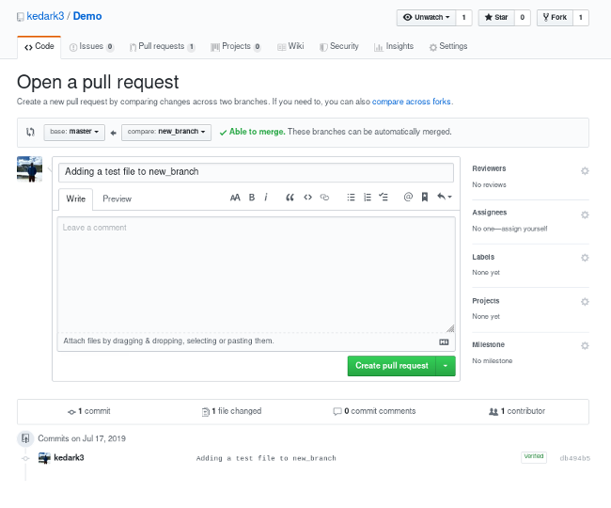
How to create a pull request
How to get your changes merged:
Fork the repository
create a new branch
make changes
commit changes
create a pull request.

Slide 16
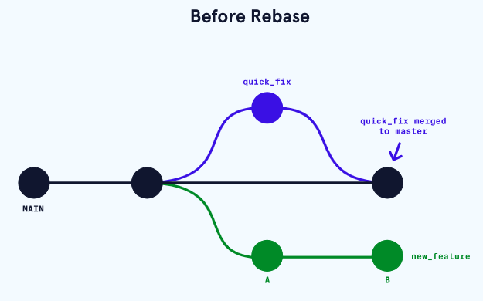
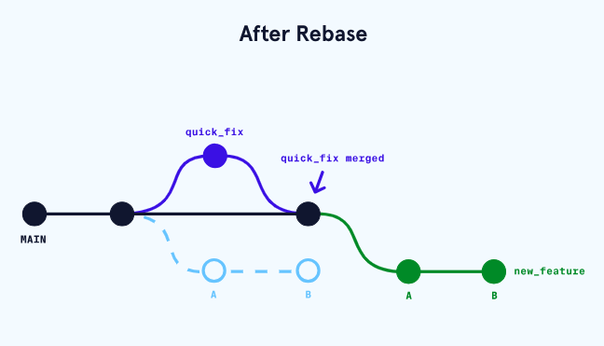
rebase pull request and amend commit
Rebase PR: A rebase pull request involves updating the base branch to incorporate changes from the source branch.
Amend Commit: Modify the most recent Git commit without creating a new one.

Slide 17
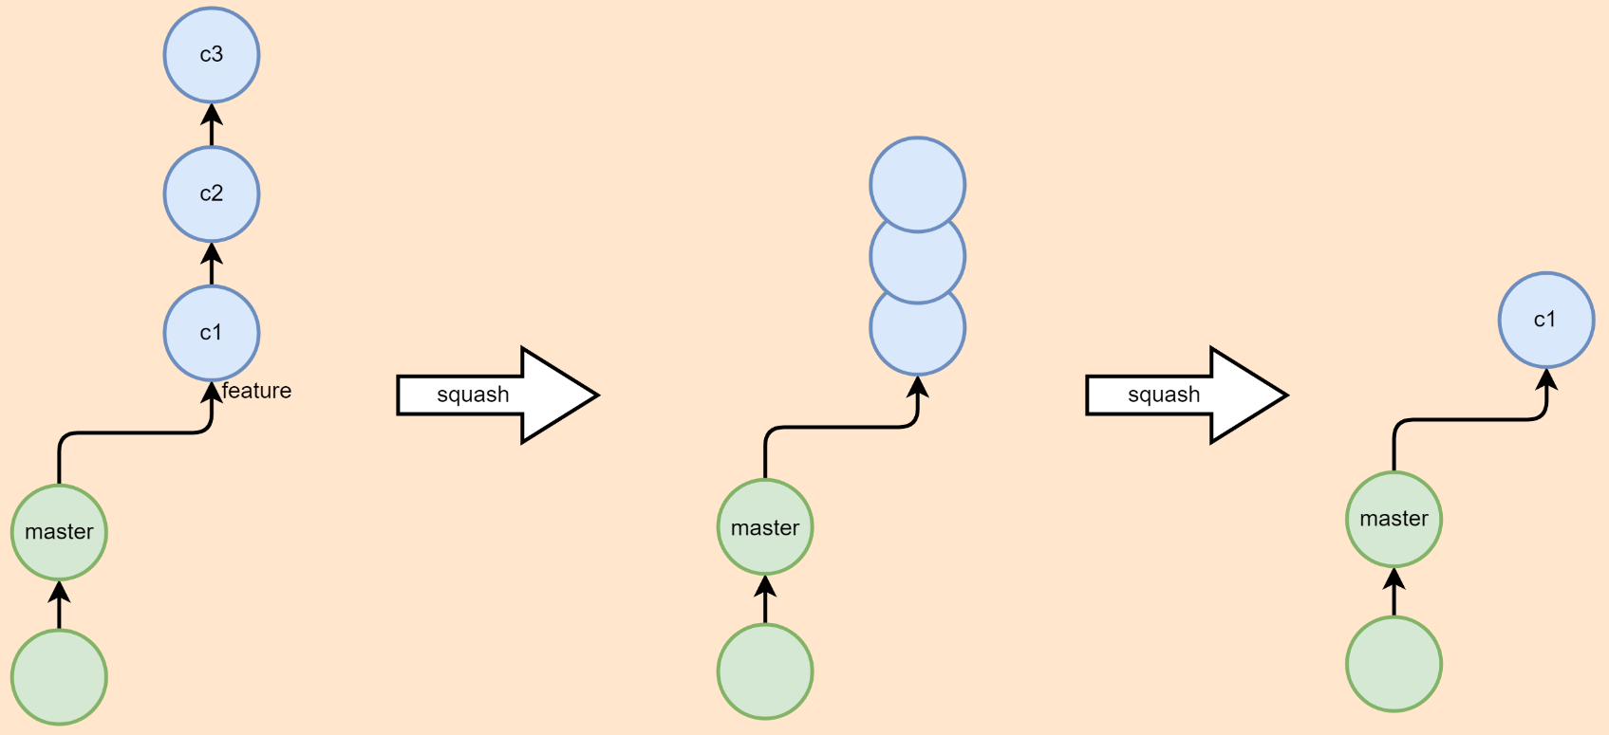
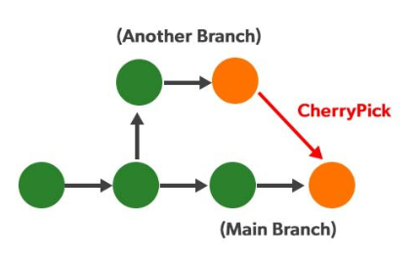
GIT SQUASH AND GIT CHERRY PICK
Git Squash: Squashing in Git combines multiple commits into one, creating a cleaner, more concise commit history. It's often used to group related commits together or to simplify a complex history.
Git Cherry-Pick: Cherry-picking is the act of selecting a specific commit from one branch and applying it to another branch. It allows you to pick individual commits and introduce them to a different branch, useful for selectively incorporating changes.

Slide 18


Questions?
SOTI Confidential - Only for use under NDA - Do not distribute

Slide 19



Thank you
soti.net
© 2020, SOTI Inc. All Rights Reserved

